Slide 1

Sentiment analysis on drug reviews
Mounica Subramani | Sai Divya Sangeetha Bhagavatula | Sushma Suresh Kalkunte

Slide 2
Introduction
Sentiment analysis measures the inclination of people’s opinion through text analysis and natural language processing.
The abundance of text available in health related forums along with public opinion are used to analyze the patients experience with the drug.
The aim of the project is to predict sentiment of reviews as "Positive", or "Negative" based on vectorized words from patients’ comments.
Sentiment Analysis of these reviews could be useful for pharmacy companies and doctors to quickly get into bad reviews and know patients' complains. Also, a lot of symptoms and drug sides were hidden under reviews, which will be great to be automatically extracted to improve the drug and help to give a better prescription.

Slide 3
Data Set
The dataset used in this project provides patient reviews on specific drugs along with related conditions and a 10-star patient rating reflecting overall patient satisfaction.
The data was obtained by crawling online pharmaceutical review sites (Druglib.com).
We try to utilize this dataset to do data mining for patient behavior and drug effectiveness in order to provide useful information to patients, doctors and pharmacy companies.

Slide 4
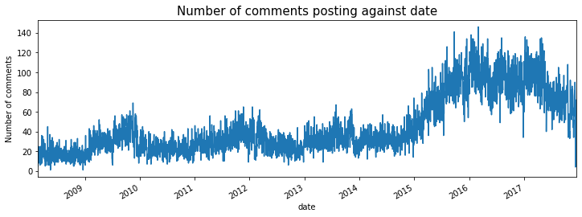
Exploratory Data Analysis

Slide 5
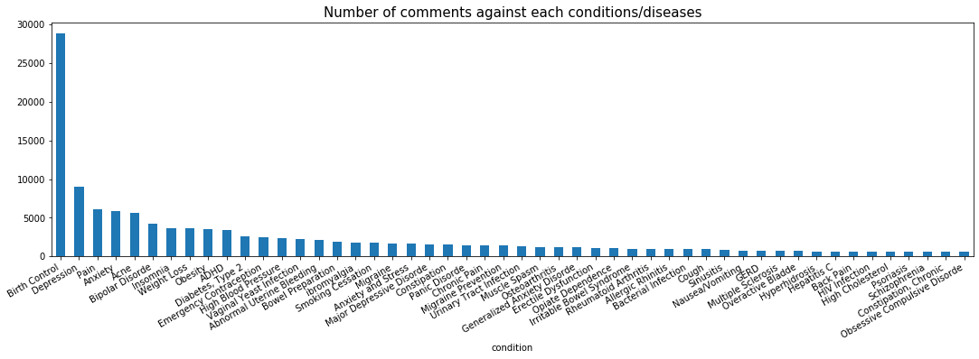
Exploratory Data Analysis

Slide 6
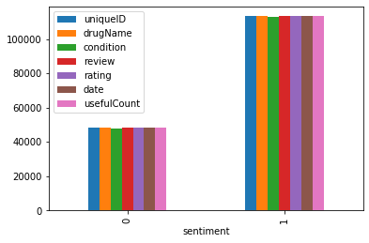
Exploratory Data Analysis
Distribution of sentiment

Slide 7
Data Preprocessing

Slide 8
Modelling techniques
Support Vector Machines
Naïve Bayes
K-Nearest Neighbors
Light Gradient Boosting
Convolutional Neural Network
Logistic Regression

Slide 9
Svm and naïve bayes

Slide 10
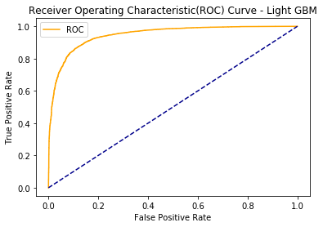
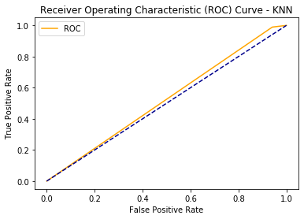
Modelling techniques
Light GBM and K-Nearest Neighbor
The accuracy of Light Gradient Boosting model on testing data is 88.05%
The accuracy of Light GBM on training data is 90%
The accuracy of K-Nearest Neighbor model on training data is 78%
The accuracy of K-Nearest Neighbor model on testing data is 77%

Slide 11
Cnn and logistic

Slide 12
Results and Conclusion

